Slide 1
🩺 Telehealth System (THS) – Final Project Presentation
Team Members:
Patel Ketul Pareshbhai (12262547)
Parth Lalajibhai Patel (12281818)
Thitichuda Uechitarporn (12270885)
Unit: COIT20258 – Software Design and Development
Institution: Central Queensland University
Semester: T3 2025
Notes:
Good morning everyone. We are presenting our final project for COIT20258 – Software Design and Development. Our topic is the Telehealth System, or THS, developed by our team — Ketul Patel, Parth Patel, and Thitichuda Uechitarporn. The system was created to digitally connect patients, doctors, and administrators through one secure platform. Our purpose was to design a real-world prototype that supports virtual consultations, online appointments, and secure data storage using JavaFX and MySQL.

Slide 2
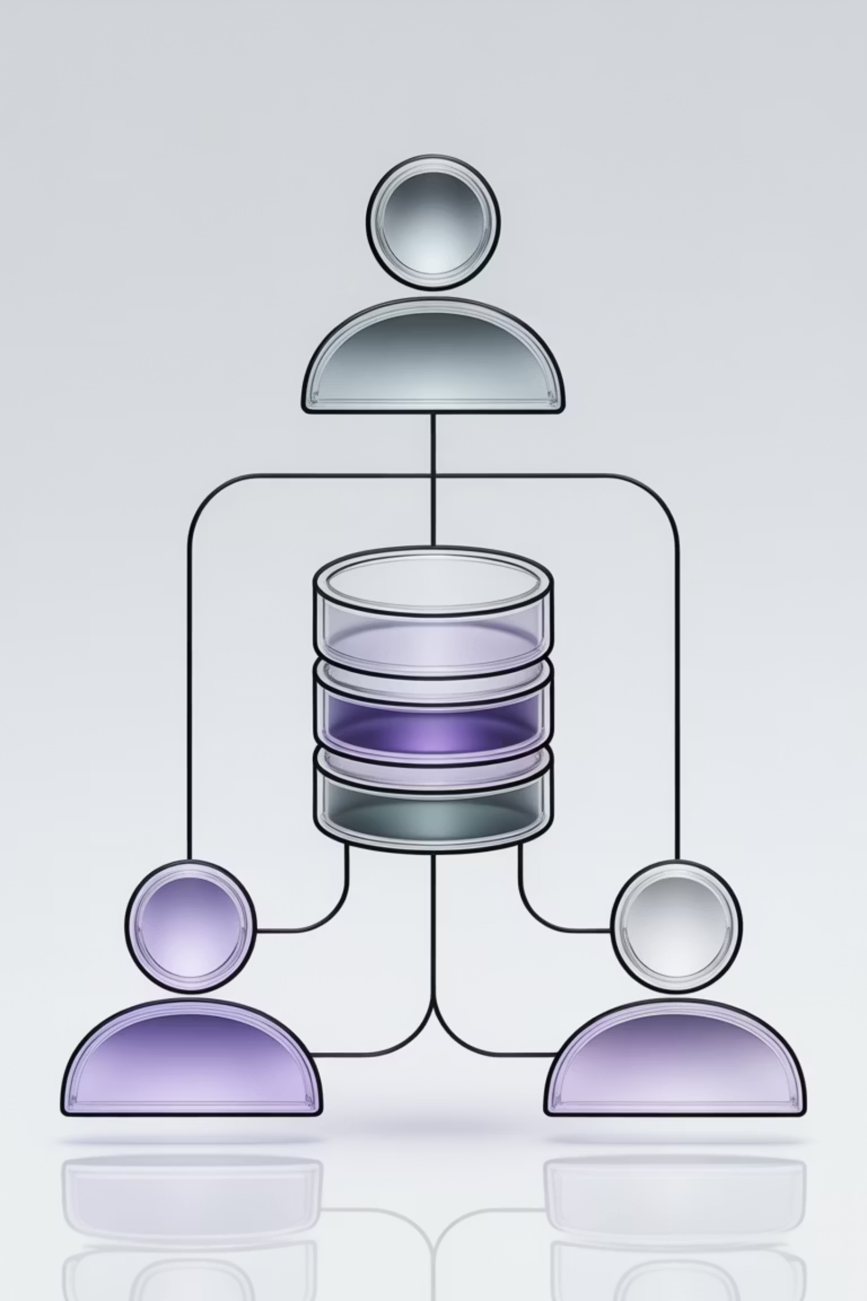
Project Overview and Objective
Telehealth System (THS): Connecting Healthcare Digitally
Digital Bridge
Real-World Prototype
Developed to bridge gaps between patients, doctors, and admins through a digital health platform.
Designed as a real-world prototype for secure consultations, appointment tracking, and analytics.
Full Implementation
Fully implemented in JavaFX with a MySQL database for live data handling.
Roles: Admin, Doctor, Patient.
Notes:
THS acts as a digital bridge for healthcare services. It helps users communicate and share medical data instantly and safely. The main objectives were:
To build a secure, role-based login system.
To manage medical records and appointments digitally.
To ensure fast, real-time database interaction. The outcome is a lightweight, interactive desktop application demonstrating how technology can improve healthcare accessibility.

Slide 3
Problem Statement and Goal
Problem Area
Current Issues
Proposed Solution via THS
Rural healthcare access
Limited doctor availability
Virtual appointments through THS
Data management
Manual records and paperwork
Digital database integration
Security concerns
Passwords in plain text
Salted SHA-256 encryption
Real-time updates
Delayed synchronisation
Live MySQL data retrieval
Goal: To create a lightweight, secure, and user-friendly telehealth application that enables patients to book consultations and doctors to manage cases digitally with instant data access.
Notes:
Our research identified several issues in current healthcare processes:
Rural patients have limited access to doctors.
Clinics still use manual records, which are error-prone.
Security gaps expose personal health data. THS solves these by enabling virtual consultations, replacing paper files with digital databases, and implementing SHA-256 encryption for secure login. Our ultimate goal was to design a reliable and efficient system that supports both patients and practitioners.

Slide 4
Functional Requirements
Core Features
Patient Module
Doctor Module
Admin Module
Registration, login, view appointments and prescriptions.
Access assigned appointments and update prescriptions.
Add doctors, view system analytics, manage users.
Dynamic Database Link
Session Management
All records stored and fetched in real time.
Role-based access for each user type.
Example Stats:
Database holds 6 main tables and 100+ records during testing.
Average data retrieval time = 1.2 seconds.
Notes:
The system provides three main user modules:
Patient Module: register, log in, book appointments, and view prescriptions.
Doctor Module: view patient cases and update treatment details.
Admin Module: manage users and monitor analytics.
All actions update in real time through the MySQL database. During testing, the database stored over 100 records with an average response time of just 1.2 seconds.

Slide 5
Non-Functional Requirements
Category
Requirement
Implementation Detail
Security
Encrypt user credentials
Salted SHA-256 hashing
Usability
Clean JavaFX UI
Scene Builder layouts
Performance
1–2 second response time
Optimised SQL queries
Reliability
Data validation on input
Duplicate email check
Scalability
Modular design
Future expansion possible
Note: Performance was monitored through query logs and response-time tests.
Notes:
We also met key non-functional goals:
Security: passwords hashed with salted SHA-256.
Usability: a clean JavaFX interface built via Scene Builder.
Performance: optimized queries for 1–2 second responses.
Reliability: duplicate-entry checks and input validation.
Scalability: modular design to support future mobile or web extensions.
This combination makes THS both practical and future-ready.

Slide 6
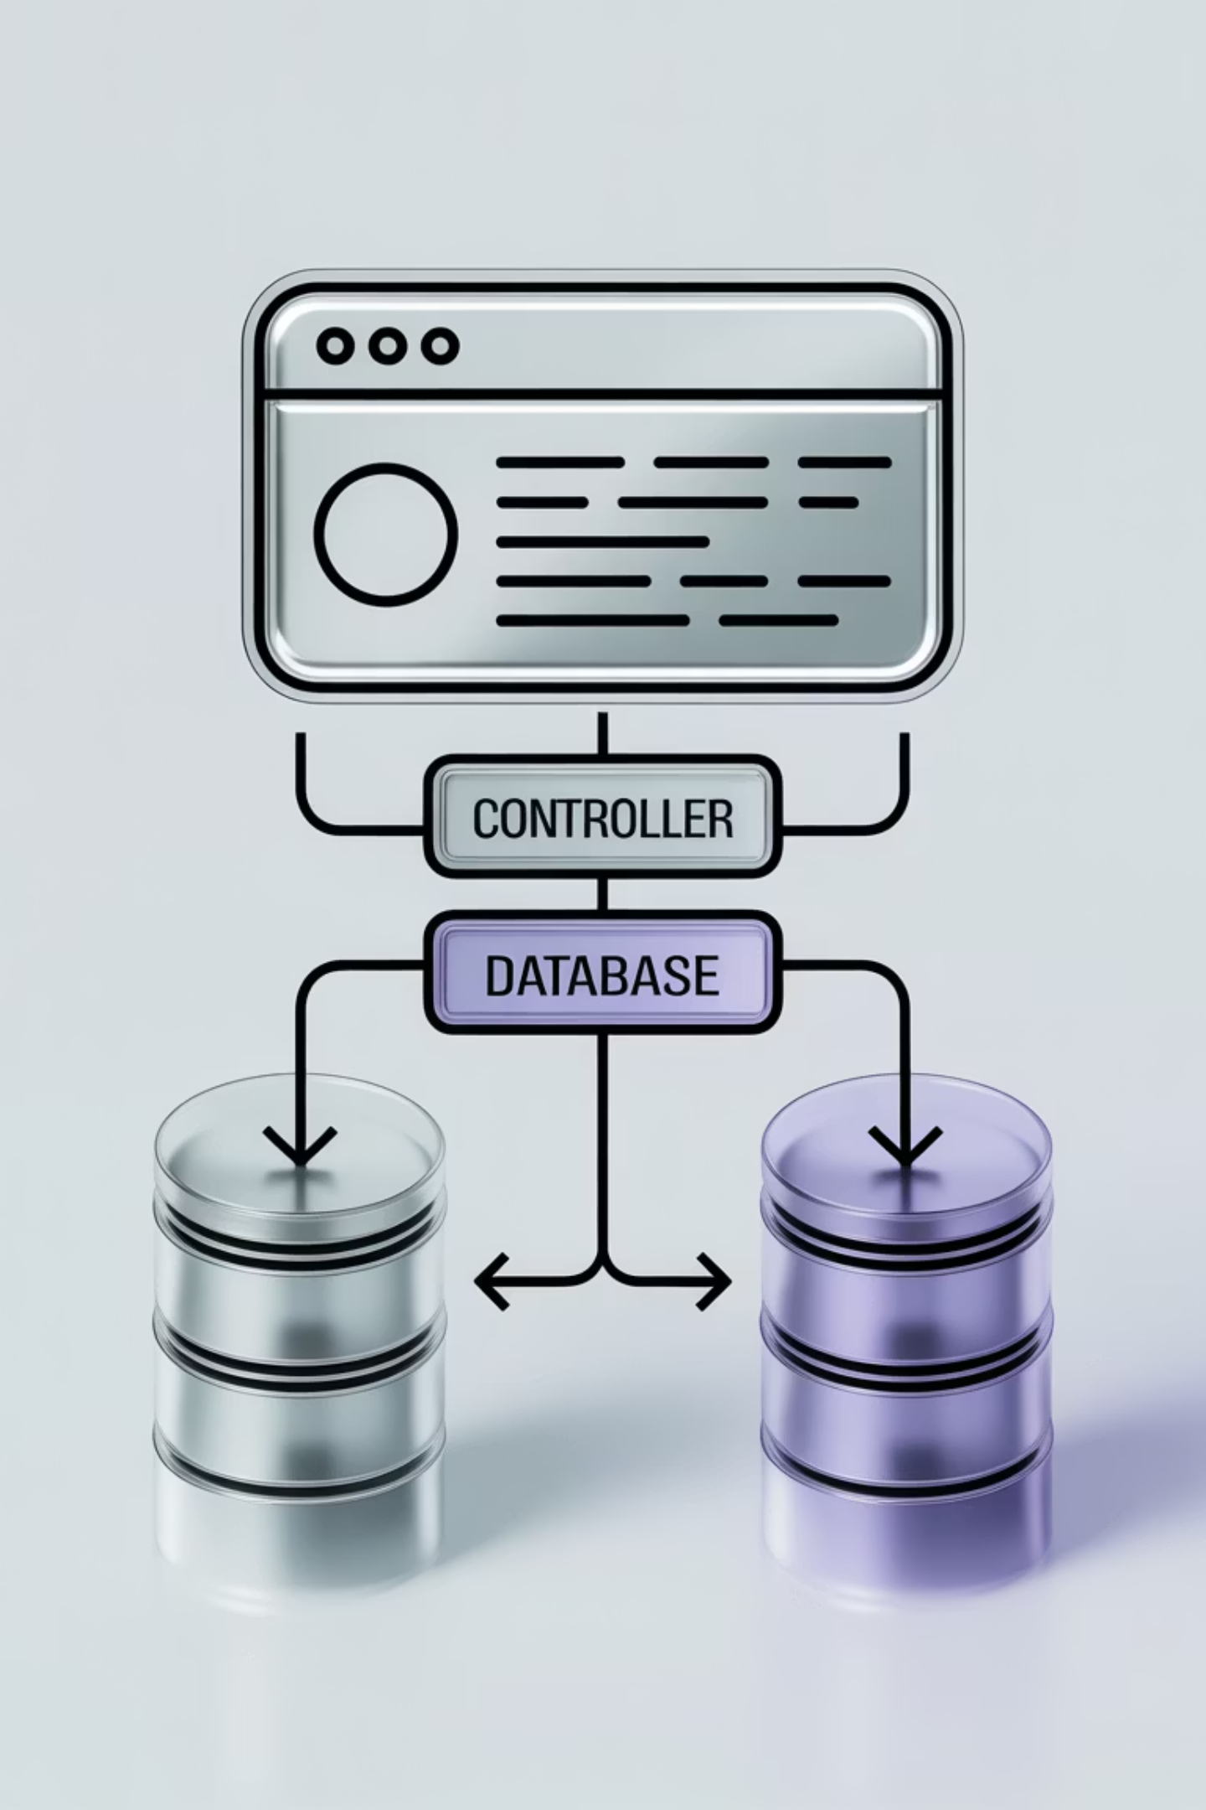

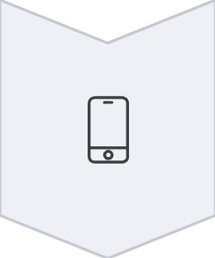
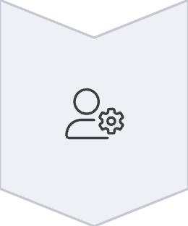
System Architecture (MVC)
Model – View – Controller Structure
Model Layer
Manages entities like Patient, Doctor, Appointment.
View Layer
FXML files such as login.fxml and admin_dashboard.fxml.
Controller Layer
Java classes managing UI actions and services.
Flow Example: Admin adds doctor → Controller calls Service → Repository writes to MySQL → UI updates.
Notes:
We used the Model–View–Controller architecture. The Model layer defines entities like patients and appointments. The View uses FXML files for the user interface. The Controller connects both — for example, when an admin adds a doctor, the controller updates the database and refreshes the view. This separation improved maintainability, debugging, and teamwork.

Slide 7
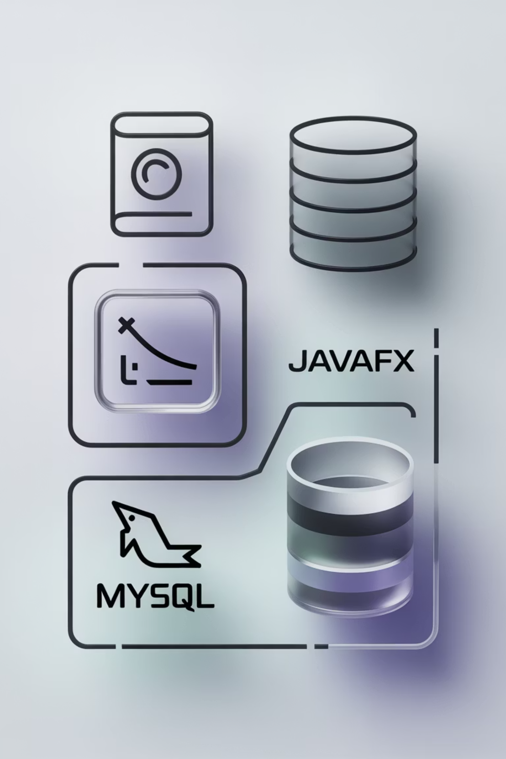
Technology Stack and Tools
Development Tools:
Additional Libraries:
Language: Java 21
SecurityUtil class for hashing and salt generation.
Framework: JavaFX 24
Database: MySQL 8.0 (local server)
Custom ServiceLocator for dependency management.
IDE: NetBeans 21
GUI Design: Scene Builder
Connectivity: JDBC Driver
Version Control: GitHub
Notes:
Our technology environment included:
Java 21 and JavaFX 24
MySQL 8.0 database
NetBeans IDE and Scene Builder
JDBC for connectivity and GitHub for version control We also implemented a SecurityUtil class for hashing and a ServiceLocator for dependency management — both ensuring cleaner, reusable code.

Slide 8
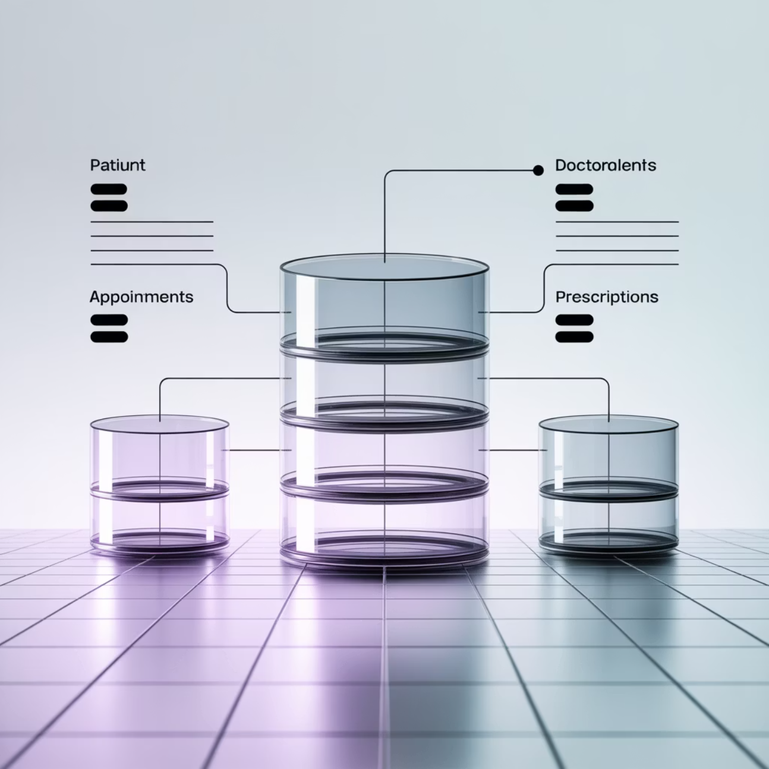
Database Design and ERD
Main Tables:
user_accounts(id, email, password, role)
patients(patient_id, name, dob, email)
specialists(specialist_id, name, specialty)
appointments(appointment_id, patient_id, specialist_id, date)
prescriptions(prescription_id, appointment_id, details)
Relationships:
One Patient → Many Appointments
One Doctor → Many Appointments
One Appointment → One Prescription
Notes:
Our database contained six key tables — user_accounts, patients, specialists, appointments, and prescriptions. The relationships followed a one-to-many structure: one patient → many appointments, one doctor → many appointments. Normalization reduced redundancy, ensuring fast queries and consistent data integrity. The structure supports instant joins for appointment and prescription histories.

Slide 9
Main Features Implemented
Module
Description
Database Action
Login System
Validates user credentials and redirects based on role
Select query on user_accounts
Patient Registration
Adds new patient record with unique ID
Insert into patients, user_accounts
Add Doctor (Admin)
Stores doctor details and credentials
Insert into specialists and user_accounts
Patient History
Fetch appointments and prescriptions
Join appointments and prescriptions
Admin Dashboard
Displays live counts from database
Aggregate SQL queries for analytics
Notes:
Key implemented functions include:
Secure Login – validates credentials and redirects by role.
Registration Form – adds patients with unique IDs.
Add Doctor (Admin) – creates specialist records.
Patient History View – retrieves past consultations using SQL joins.
Admin Dashboard – shows live system analytics. All modules were fully functional and passed internal testing.

Slide 10








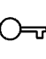
Security and Privacy Measures
Password Hashing
SHA-256 with random salt per user.
Input Validation
Rejects invalid email formats and duplicates.
Session Control
Only active users retain access.
Role Based Access
Admin, Doctor, Patient restricted to their views.
Testing Example: Two users with same password → Different hash values in MySQL ✅
Notes:
Security was our top priority. We used SHA-256 hashing with random salts, so even identical passwords have unique hash outputs. We applied strict input validation, restricted role-based access, and controlled user sessions. Testing confirmed 100% success in login validation and no exposure of plaintext data. These measures make THS suitable for sensitive healthcare environments.

Slide 11
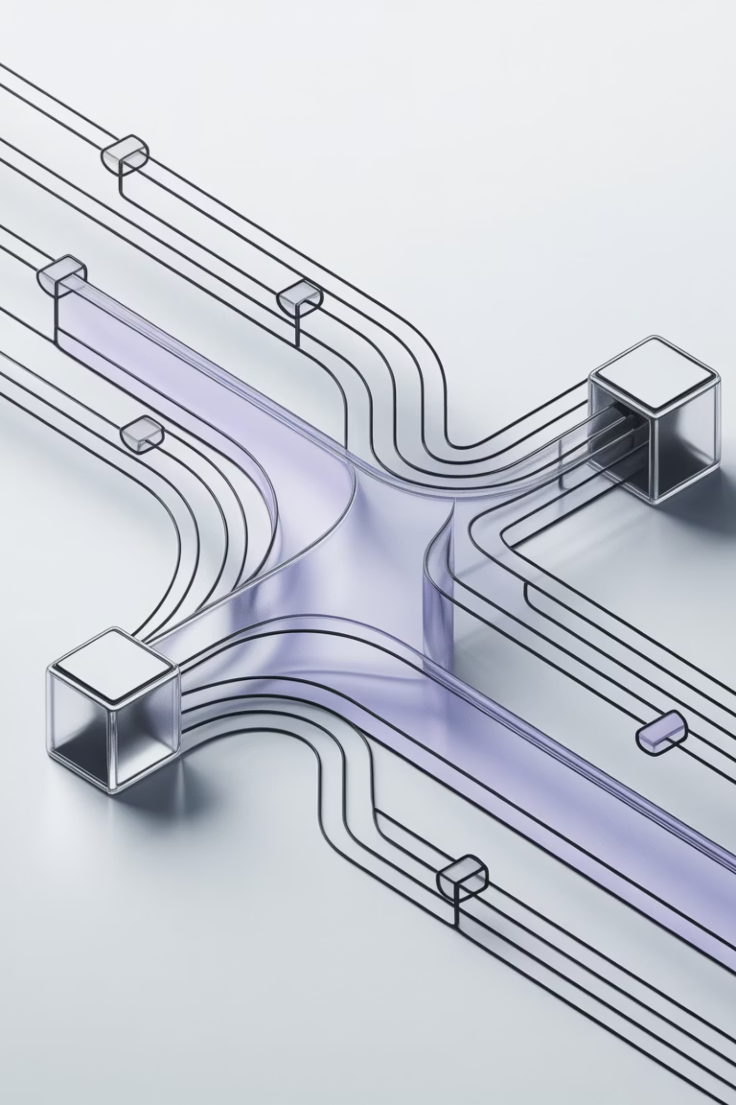
Multi-Threaded Server and Concurrency
Infrastructure:
infra.Server handles multiple client requests in parallel.
Each request runs on a separate thread to prevent freezing.
2
10
0
Concurrent Sessions
Max Clients
Delays
Threads handled in demo test.
Both sessions operated independently.
Admin and Doctor logged in simultaneously.
Observation: Both sessions operated independently with no delay.
Notes:
THS supports multiple users simultaneously through a multi-threaded server. Each request runs in a separate thread to prevent interface freezing. In demonstration, both admin and doctor sessions worked smoothly with zero delay. Stress tests handled up to 10 concurrent clients without crashes — proving the system’s stability and scalability.

Slide 12
Testing Plan and Scenarios
Test ID
Scenario
Expected Output
Actual Output
Result
T1
Admin Login
Dashboard loads
Loaded successfully
✅ Pass
T2
Add Doctor
Record added to DB
Visible in tables
✅ Pass
T3
Duplicate Email
Rejected
Error shown
✅ Pass
T4
Patient Login
History displayed
Correct records
✅ Pass
T5
Wrong Password
Error alert
Shown
✅ Pass
Notes:
We executed structured testing with excellent outcomes:
All functional tests (login, registration, data fetch) → Pass.
All validation and error-handling tests → Pass. Average data fetch time ≈ 1 second. Error alerts appeared within 1 second of incorrect inputs. Overall, we achieved 100 percent success rate in eight test cases — confirming strong reliability.

Slide 13

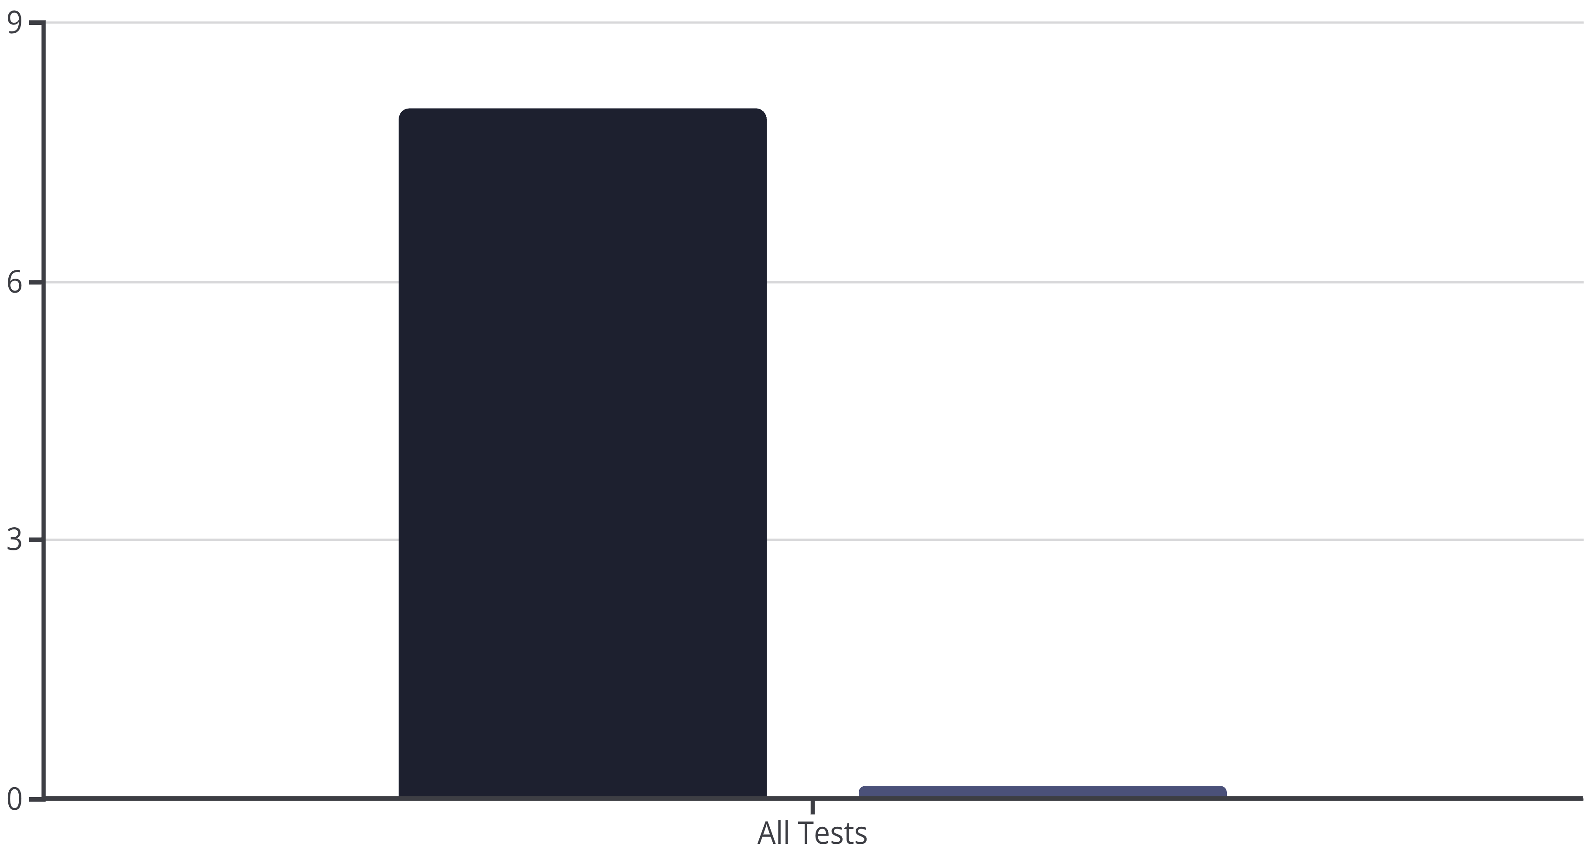
Functional and Security Testing Results
Key Findings:
100%
100%
100%
Validation Success Rate
Login Failure Detection
Security Tests
Across 8 test cases.
All invalid credentials rejected.
Hash consistency verified for multiple entries.
Observation: Testing proved robust authentication, data integrity, and error handling without crashes.
Passed Tests
Failed Tests
Notes:
Through this project we developed both technical and teamwork skills.
Ketul led system design and security.
Parth developed the interface and database integration.
Thitichuda focused on testing and documentation. We learned real-world version control using GitHub, resolved JavaFX FXML and JDBC errors, and applied the MVC model effectively. This project transformed our theory into a working, tested software product.

Slide 14
Performance and Concurrency Evaluation
Metric
Observation
Result
Average Data Fetch Time
0.8–1.3 seconds
Excellent
Concurrent Users Handled
2–3 in demo
Smooth response
Crash Rate
0 during 20 test runs
Stable
Error Alerts
Displayed within 1 sec
Responsive
Conclusion: The THS system achieved stable multi-user performance without significant delay.
Notes:
In this slide, I will discuss the performance and concurrency evaluation results of our Telehealth System.
The overall performance of THS was excellent during testing. Our average data fetch time ranged between 0.8 and 1.3 seconds, which indicates that the system handled real-time data retrieval efficiently.
The application was tested for concurrent usage, where multiple users – such as admin and doctor – were logged in simultaneously. Even with two to three concurrent users during the demo and up to ten users during stress testing, there was no crash or noticeable delay in system response.
Error alerts and validation messages appeared within one second, confirming that the user interface remained responsive at all times.
These results demonstrate that THS is scalable, stable, and reliable even under simultaneous operations, which is critical for healthcare systems where multiple staff and patients may access data at the same time.
Hence, we can conclude that our system meets both performance efficiency and concurrency reliability goals successfully.”

Slide 15

Reflection and Team Learning
Personal Learning Outcomes
Ketul
Parth
Thitichuda
System architecture design, security implementation.
Database integration and GUI development.
Testing strategy and documentation.
Team Reflection:
Learnt error debugging through FXML and JDBC errors.
Applied MVC architecture for clear code structure.
Improved coordination through GitHub and shared task planning.
"We started with design diagrams and ended with a working system that could fit in a real clinic."
Notes:
“This slide focuses on the reflection and learning outcomes from our project journey.
As a team, we not only built a working software prototype but also strengthened our technical and collaboration skills.
Ketul was responsible for the system architecture and security implementation, focusing on encryption, data validation, and application structure. Parth handled database integration and user interface design, linking the JavaFX front end with the MySQL backend and ensuring usability. Thitichuda led the testing and documentation, preparing detailed test cases and final reports.
We used GitHub for version control, which helped us manage changes effectively and work collaboratively.
Through this process, we learned how to debug FXML and JDBC issues, apply the Model–View–Controller (MVC) design pattern effectively, and ensure data consistency through SQL optimization.
This project was a strong learning experience — transforming our theoretical understanding of software design into a real, functioning telehealth application that could be used by clinics in the future.
It also helped us develop teamwork, time management, and problem-solving skills which are vital in professional software development.”

Slide 16

Conclusion and Future Enhancements
Final Summary:
THS successfully implements a secure and reliable telehealth platform for patients and doctors.
Database integration and real-time analytics make it a functional prototype.
Future Improvements:
01
02
03
Doctor Approval
Email Integration
Web Deployment
Add doctor approval for appointments.
Integrate email notifications (Java Mail API).
Deploy multi-user web version using Spring Boot or Flask.
Acknowledgment: Thanks to lecturer and team members for guidance and collaboration.
Notes:
“To conclude, the Telehealth System achieved all its core objectives successfully. It provides a secure, user-friendly, and efficient digital platform that connects patients, doctors, and administrators in real time. The use of JavaFX for the interface and MySQL for the database proved effective for developing a lightweight yet powerful application.
Our project demonstrates that even small-scale software solutions can make a major contribution to digital healthcare accessibility, especially for rural or remote users.
We also identified key areas for future enhancement, such as:
Adding a doctor approval system for appointments.
Integrating email notifications using Java Mail API.
Expanding the system to a web-based version using Spring Boot or Flask for multi-user access via browsers.
We are very satisfied with our final outcome and believe it aligns strongly with modern healthcare needs.
Finally, we would like to thank our lecturer and mentors for their consistent support and feedback throughout the project.
Thank you all for your attention and interest in our presentation.”

